Slide 1
Stopping the Chain of Infection
September/October 2012 issue of Radiologic Technology.
Directed Readings In the Classroom

Slide 2
Instructions:
This presentation provides a framework for educators and students to use Directed Reading content published in Radiologic Technology. This information should be modified to:
Meet the educational level of the audience.
Highlight the points in an instructor’s discussion or presentation.
The images are provided to enhance the learning experience and should not be reproduced for other purposes.

Slide 3
Introduction
Billions of dollars and thousands of lives are lost each year because of communicable diseases. The basic component of every communicable disease transmission is the chain of infection. By breaking just 1 link in the chain, a communicable disease cannot be passed on to another individual. Radiologic technologists have the ability to continue the chain of infection or stop transmission. This article explores how a disease is transmitted and what techniques are available to stop transmission.

Slide 4
Chain of Infection
The entire chain of infection must be intact for a person to become infected. If just 1 piece of the chain is missing, the infectious disease cannot spread. The chain of infection is made up of 6 components:
infectious agent
a reservoir
portal of exit
mode of transmission
portal of entry
susceptible host

Slide 5
Hospital-acquired Infections
HAIs are nosocomial infections. In other words, the patient does not have the infection upon entering a health care facility, but becomes infected while being treated at the institution. Several factors in the health care environment make the chain of infection difficult, but not impossible, to break; patients often have weakened immune systems and are undergoing invasive procedures, and health care staff come into contact with multiple patients during their shift. Every health care worker who is responsible for patient care or for cleaning patient equipment can be a part of the solution or part of the problem of disease transmission.

Slide 6
Clostridium difficile
Radiologic technologists must be aware of how their role in the care of a patient may or may not affect the spread of infectious diseases.
Clostridium difficile (C diff) is a bacterial infection that causes inflammation of the colon (colitis). The symptoms of C diff are diarrhea fever. It can be severe enough to cause death, although this is rare. Once exposed to C diff, a person usually shows signs of the illness 2 to 3 days later.

Slide 7
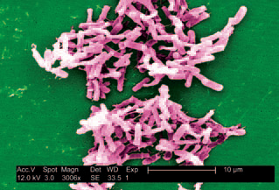
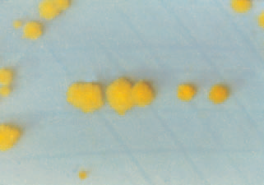
Clostridium difficile
This micrograph depicts Clostridium difficile bacteria
from a stool sample culture obtained using a 0.1 μm filter.
C diff colonies grown on cycloserine mannitol agar
after 48 hours.

Slide 8
Clostridium difficile
C diff is found in the human intestinal tract. The bacteria exit its reservoir through fecal material. The mode of transmission to another person is thought to occur 1 of 3 ways:
From a health care worker with contaminated hands.
Through contact with contaminated fomites (eg, positioning aides, blood pressure cuffs, image receptors, and radiography tables).
By direct contact with an infected person’s feces.
The portal of entry for C diff is the mouth; however, the contact does not have to be direct. For example, if a patient’s leg touches a contaminated imaging plate, she then touches her leg where the imaging plate was, and then touches her mouth to cover a cough.

Slide 9
Contact Precautions
Contact precautions require the use of gloves and gowns when a health care worker will be coming in contact with a patient or objects in a patient’s environment that may be contaminated with this pathogen. Alcohol-based hand rubs are ineffective against this pathogen. Health care workers should wash their hands with soap and water after working with a patient known to be infected.
When the examination is complete, the radiology suite must be cleaned thoroughly with a chlorine containing cleaner or another sporicidal agent. No other examinations should be performed in the radiology suite until proper cleaning is completed.

Slide 10
Influenza
The term “flu,” which influenza is also known by, is commonly incorrectly used to describe gastrointestinal illness like an upset stomach, diarrhea, or vomiting. However, influenza is often a serious respiratory illness. The symptoms include fever, cough, sore throat, a runny or stuffy nose, muscle or body aches, headaches, and fatigue. Although vomiting or diarrhea may present, this is more common in children than adults and is most likely due to a high fever rather than the actual influenza pathogen.

Slide 11
Flu Transmission
The transmission of an influenza virus from a human reservoir is through droplet contact. Droplets typically cannot be seen with the naked eye. Droplets can exit the body through coughing, sneezing, and talking. They attach to particles in the air and float to an object (eg, door handle) or another person. The influenza virus can live on an object for as long as 2 days. Even though the length of life outside the body is rather long, influenza is most commonly transmitted by direct contact, such as via a handshake.

Slide 12
Flu Transmission
Once the virus exits its human reservoir, there must be a portal of entry into a new person to pass the virus along. The portal of entry for the influenza virus is through the nose or mouth. For transmission, an infected person could sneeze and the released virus could land on a door handle, which is then touched by an unsuspecting person, who then touches his or her nose or mouth. It is through a simple act such as this that influenza spreads.

Slide 13
Measles
Although health care workers do not often see measles, it is a serious threat. Measles causes symptoms of fever, tiredness, anorexia, runny nose, cough, and rash. Koplik spots also appear, which are white spots with a bluish center found inside of the mouth — a characteristic of measles solely. The rash travels outside the mouth, starts on the face, then spreads across the whole body to the toes. Approximately 3 to 5 days after the body rash begins a person’s temperature rises. Temperatures can rise upwards to 104°F. Although these symptoms are unpleasant, the possible complications of measles cause deeper concern.

Slide 14
Measles
Common measles complications are diarrhea, ear infection, pneumonia, encephalitis, seizure, and even death.
Measles symptoms arise in a newly infected individual 7 to 14 days after exposure. A person is contagious with measles up to 4 days prior to the rash appearing and 4 days after the rash has appeared. Of all the infectious diseases, measles is 1 of the most contagious. If just 1 person has measles, 90% of all those around this single person will contract measles if they are not vaccinated.
Nonimmune health care workers should not care for patients with measles, if at all possible.

Slide 15
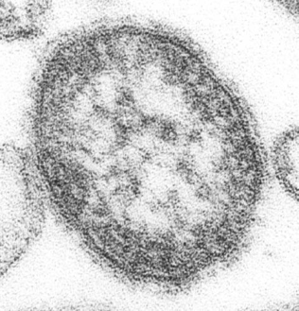
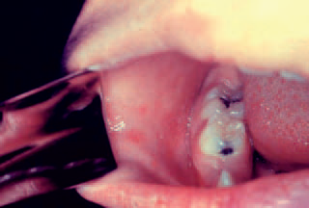
Measles
This thin-section transmission electron micrograph shows a single virus particle, or virion, of measles.
In the beginning stages of measles, a sign of onset is the eruption of Koplik spots on the mucosa of the cheeks and tongue, which appear as irregularly-shaped, bright red spots often with a bluish-white central dot.

Slide 16
Mumps
Fever, headache, muscle aches, tiredness, loss of appetite, and swollen and tender salivary glands are the symptoms of mumps. The most serious complications occur when an individual contracts mumps at an older age. These complications include swelling of the testicles in men, swelling of the ovaries or breasts in women, encephalitis, meningitis, and temporary or permanent deafness. The pathogen that causes mumps is a virus found only in a human reservoir. It exits its human reservoir via mucous when an infected individual coughs, sneezes, or talks. The virus also is found in saliva, so cups and utensils can be contaminated.

Slide 17
Mumps
After a person has been exposed to mumps, it can take from 12 to 25 days for symptoms to present. A person can be contagious for up to 6 days prior to noticeable symptoms. Some cases of mumps are mild and the individual does not realize he or she has the disease. After the swelling in the salivary glands has presented, the person is contagious for an additional 5 days. If nonimmune health care workers have contact with a patient with mumps, they may need to miss work for 26 days. A nonimmune health care worker is considered to have contact with a mumps patient if they are within 3 ft of the patient without the use of a surgical mask.

Slide 18
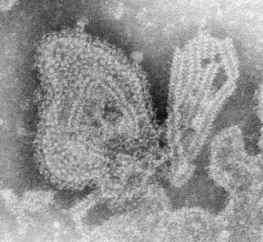
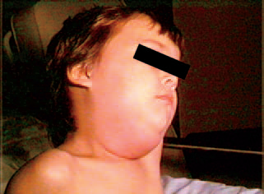
Mumps
Negatively-stained transmission electron micrograph
showing the ultrastructural features displayed by the mumps virus.
Photo of a child with a mumps infection. Note the characteristic
swollen neck region due to an enlargement of the boy’s salivary glands.

Slide 19
Rubella
Rubella, or “German measles,” is characterized by a rash that starts approximately 14 days after exposure. In addition to a rash, older children and adults have a mild fever and swollen lymph nodes. Adult women can develop pain and stiffness that lasts up to a month, in their hands, wrists, and knees.
People with rubella may be contagious for up to 7 days prior to the rash appearing, and they continue to be contagious for 5 to 7 days after the rash appears. Once the virus has exited its human reservoir, airborne droplets enter a new host through the nose or mouth. A person who is not vaccinated against the disease is susceptible to contracting rubella.

Slide 20
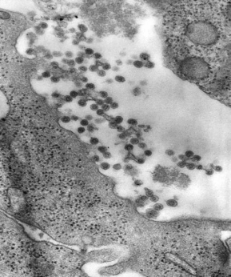
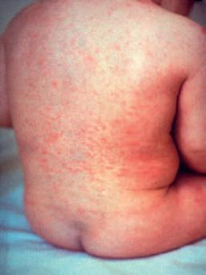
Rubella
This negatively-stained transmission electron micrograph shows the rubella virus, in the process of budding from the host cell surface to be freed into the patient’s system.
Rash of rubella on a child’s back. Distribution is similar to that of measles, but the lesions are less intensely red

Slide 21
Pertussis
Pertussis, also known as whooping cough, begins with signs and symptoms similar to those of the common cold. A person has a mild cough, runny nose, and maybe a lowgrade fever. Then as 1 to 2 weeks pass, those infected with pertussis will begin to have severe coughing fits which may cause them to vomit or turn blue from not being able to catch their breath. The person has a characteristic sound of a whoop when they try to catch their breath. These severe coughing fits generally are worse at night and can last for up to 10 weeks.

Slide 22
Pertussis
Pertussis is highly contagious, and 80% of susceptible household contacts contract pertussis from the first case. It most severely affects young children and infants. Complications of a pertussis infection in adults are rare, but include weight loss, urinary incontinence, syncope, rib fractures from severe coughing, hernia, pneumothorax, rectal prolapse, subdural hematomas, and seizures.
Pertussis is a bacterial infection that exits its human reservoir via respiratory secretions. Although the infectious respiratory secretion droplets can contaminate surfaces such as doorknobs, they primarily transmit to another person via the air.

Slide 23
Varicella
Patients with varicella-zoster virus (VZV) — better known as chickenpox — present with a headache, fever near 102°F, malaise, loss of appetite, and an itchy rash. These symptoms can take 10 to 21 days to appear after exposure with an infectious person. A person is contagious with VZV 1 to 2 days prior to the rash appearing, and then until all skin lesions scab over. The contagious stage usually takes 5 to 10 days to complete. If a nonimmune health care worker has close contact with a patient infected with VZV, he or she may be infective for 8 to 21 days. Close contact is defined as in the same room or face-to-face.

Slide 24
Varicella
Unlike measles, mumps, and rubella, an individual can contract varicella more than once. However, the second infection is called herpes zoster (shingles). Shingles mainly occur in adults older than 40 years of age. The symptoms of shingles are a painful itchy rash, tingling in the area of the rash that can last weeks, headaches, photophobia, chills, upset stomach, and fever. Anyone who has recovered from VZV may develop shingles. Immunocompromised individuals and people who are unvaccinated are the most susceptible to developing shingles.

Slide 25
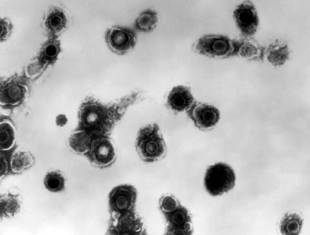
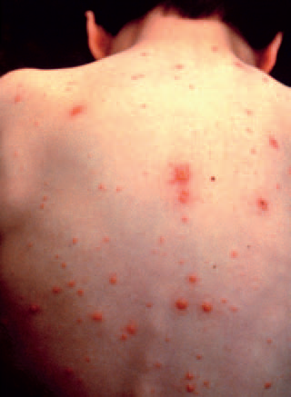
Varicella
Transmission electron micrograph of varicella-zoster virions from vesicle fluid of a patient with chickenpox.
This child presented with the characteristic pancorporeal varicella, or chickenpox, lesions.

Slide 26
Hepatitis B
An estimated 38 000 Americans are infected with hepatitis B each year. In 50% of the cases, they have no symptoms, making them unaware of their ability to pass on the illness to another person. The signs and symptoms of hepatitis B, if present, are fever, fatigue, loss of appetite, nausea, vomiting, abdominal pain, dark urine, clay-colored bowel movements, joint pain, and jaundice. Once an individual is infected with hepatitis B, it can take 60 to 150 days for any symptoms to appear. Known complications of a hepatitis B infection are chronic hepatitis B, cirrhosis of the liver, liver cancer, and fulminant hepatitis.

Slide 27
Hepatitis B
When a person is infected with hepatitis B, 90% of adults will have an acute onset, where they:
Have no symptoms or mild flu-like symptoms.
Recover from the infection.
Develop antibodies against future hepatitis B infections.
The other 10% of adults have chronic hepatitis B where symptoms affect them for the rest
Infants with hepatitis B are 90% more likely to develop chronic hepatitis; children younger than 5 years of age are 50% likely to develop chronic hepatitis B, if infected. of their life.

Slide 28
Hepatitis B
The pathogen that causes hepatitis B is a virus (HBV). HBV exits its human reservoir through blood, semen, and saliva. The highest concentration of HBV is found in the blood. Saliva can transmit HBV through bites; however, kissing and the use of the same utensils are unlikely modes of transmission. There are no known transmissions of HBV through tears, sweat, breast feeding, coughs, sneezing, urine, or stool.
HBV can enter another individual via sexual contact (passing of semen or vaginal secretions), direct contact with contaminated needles or other sharps (needle stick), or even through contaminated inanimate objects.

Slide 29
Standard Precautions
Health care workers, including radiologic technologists, learn standard precautions in educational programs and at the beginning of their careers. Standard precautions are often second nature and automatic for health care workers today. However, this automatic obedience can cause a lack in compliance. When things are done without thinking, the importance of a simple action can be lost.

Slide 30
Standard Precautions
In 1970, the CDC made recommendations to apply standard precautions — an evolving set of recommendations that change as more is learned about the transmission of pathogens. In 2007, the CDC added 3 new parts to standard precautions:
Respiratory hygiene/cough etiquette.
Safe injection practices.
The use of masks for insertion of catheters or injection of material into spinal or epidural spaces via lumbar puncture procedures.

Slide 31
Equipment
Equipment found in the radiology suite that is used daily (eg, imaging plates) can be a source of disease transmission if not properly cleaned. After every patient, the examination table, upright Bucky, x-ray tube, exposure switch, and health care workers’ hands should be cleaned to minimize disease transmission.

Slide 32
Hand Hygiene
A part of the standard precautions is hand washing. Reports published as early as 1825 state hand washing helps eliminate odors and disease transmission. Unfortunately for patients, even with more than 180 years of knowledge, not all health care workers comply.
According to study published in 1999, health care workers had proper hand hygiene only 48% of the time. This lack of compliance helps pathogens transmit to other individuals and continue the chain of infection.

Slide 33
Hand Washing
Hands should be washed before patient contact, before invasive procedures, and after the removal of gloves. In addition to health care workers washing their hands before and after caring for a patient, hands should be washed:
Before and after eating.
After use of a restroom.
After changing a diaper.
After blowing your nose, coughing, or sneezing.
After touching an animal.
After touching garbage.

Slide 34
Hand Washing
Health care workers should take between 40 and 60 seconds to wash their hands properly. The following steps will greatly minimize the transmission of pathogens:
Wet your hands and then apply soap.
For approximately the next 30 seconds, rub your hands together vigorously.
After the vigorous rubbing, rinse your hands under water, dry them off with a disposable towel, and then use the towel to shut off the water.
If you are washing your hands in a room with a light switch or door that must be opened, use the paper towel to open the door and turn off the switch.

Slide 35
Hand Rub
To use a hand rub properly, a health care worker should allot 20 to 30 seconds. Hand rubs should only be used for hand hygiene. If hands are noticeably soiled they must be washed with soap and water. To help sanitize hands, a health care worker should dispense a palm full of the hand rub solution into a cupped hand. He or she must then rub palms together to spread the solution around, then rub the back of the hand, interlace fingers to scrub between them, rub the thumbs individually, and then rub the fingertips into the palm in a circular motion. These steps should be continued until the hands are dry. Hands may not be safe if the continuous rubbing motion is stopped prior to the hands being dry.

Slide 36
Contact Precautions
When caring for a patient under contact precautions, health care workers must wear gowns and gloves. The gowns and gloves should be disposed of prior to exiting the patient’s room. Immediately after removing their gloves, health care workers should wash their hands. If an imaging plate is being used with a patient under contact precautions, it must be protected with a plastic covering. After removing the plastic covering, the imaging plate must be wiped clean with the manufacturer recommended solution.

Slide 37
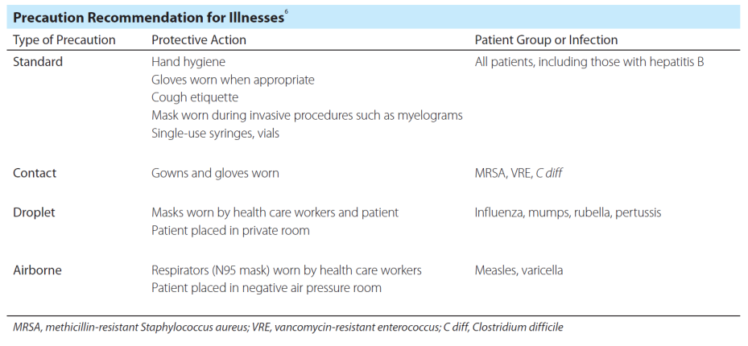
Precaution Recommendation

Slide 38
Vaccination
Other defenses available to stop the chain of infection are vaccination and immunization. Although these terms often are used interchangeably, they differ. To be immune means to be free of the possibility of acquiring a specific disease. Immunity results from an individual’s previous exposure to an infectious pathogen, either through a vaccine or through traditional infection.

Slide 39
Vaccine Characteristics
A vaccine should have certain characteristics. It should:
Be harmless.
Be easily administered to large numbers of healthy adults and children.
Be able to elicit protective immune responses in a very high proportion of people vaccinated.
Work against various strains of the virus or at least geographically relevant strains.
Provide long-lasting protection with few doses or boosters.
Be cost-effective and easy to transport.

Slide 40
Vaccination
Vaccines can be divided into 2 broad categories: live vaccines, which use attenuated infectious agents to mimic natural infection, or inactivated pathogens, which cannot replicate or infect the host. In addition to the targeted agent, a vaccine usually contains suspension fluids, preservatives, stabilizers, and adjuvants. To date, a large percentage of vaccines are made of live-attenuated microorganisms. To help reduce the spread of infections in health care facilities, the CDC recommends health care workers be vaccinated against influenza, measles, mumps, rubella, hepatitis B, and chickenpox.

Slide 41
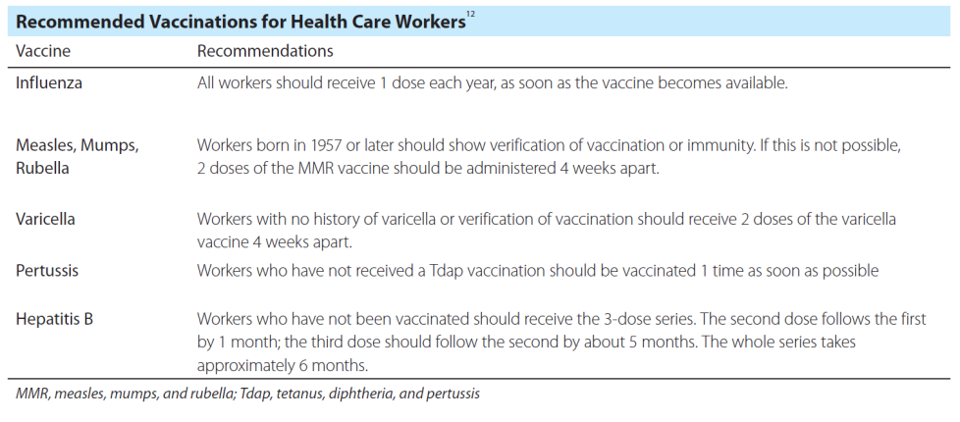
Recommended Vaccinations

Slide 42
Conclusion
Breaking the chain of infection is the key to stopping the transmission of pathogens in health care facilities and communities worldwide. Only 1 piece of the chain has to be missing to stop transmission. The correct washing of hands in many cases is the first line of defense in stopping that chain. Proper health care worker vaccination and the use of proper precautions for specific diseases also are crucial. By having fewer infections, the burden of HAIs would decrease and the associated mortality rate would fall. All health care workers should work toward reducing HAIs and other infectious pathogens.

Slide 43
Discussion Questions
Thinking about the chain of infection, how are hospital-acquired infections transmitted?
Discuss some methods Radiologic Technologists can stop the chain of infection.
Discuss why vaccinations are recommended for health care workers.

Slide 44
Additional Resources
Visit www.asrt.org/students to find information and resources that will be valuable in your radiologic technology education.

